Slide 1
KP LEAKAGE: CANISTER DOCK INVESTIGATION

Slide 2
Issue Definition
What We Know
Analysis
Investigations and Results

Slide 3
Issue Definition
A number of customers and agents have reported to have experienced cases of leakage from the canister dock area when refilling canisters. 39 tickets have been raised between 18-09-19 and 22-03-20.
Goal:
To find out the root cause of leakages from the canister dock area and suggest improvement in the process or design.
Develop a scheduled maintenance to empty sump before leakage occurs.

Slide 4
What We Know
Cases of flooded smart valves lead to accumulation of excess fuel into the sump area.
Reported cases of KPs under-dispensing without triggering an error 092 meaning some of the fuel goes into airline or sump.
Few cases reported on faulty canisters not completely opening the fuel line during a dispense.
Issues with Smart valve part 1 having inconsistent dimensions during fabrication.
53mm O-ring deforming if misaligned during assembly of the SMV.

Slide 5
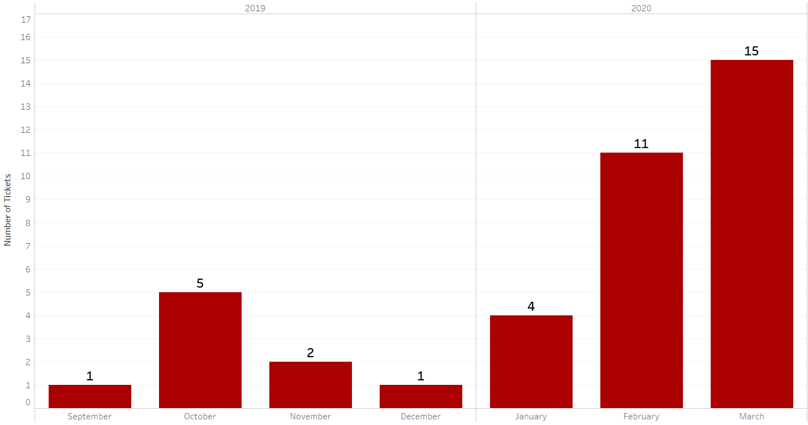
What we know: Frequency by month
Higher numbers in Feb and March due to the increased number of dispenses.

Slide 6
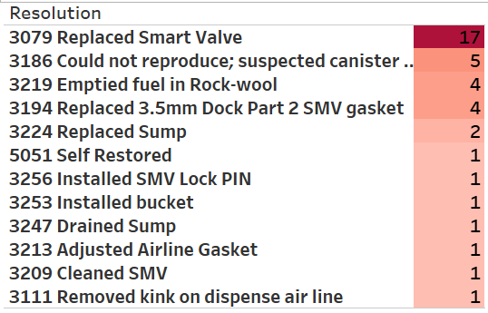
Analysis 1: Resolutions applied.
Highest resolution applied has been replacement of the SMV and emptying fuel in rockwool/draining sump.
2 out of 17 cases where an SMV has been replaced have had recurrences afterwards: KP-0236 and KP-0119 (worth investigating other causes apart from SMV for these).
Same resolution, different name: emptied rockwool and drained sump (Feedback to the NOC team).

Slide 7
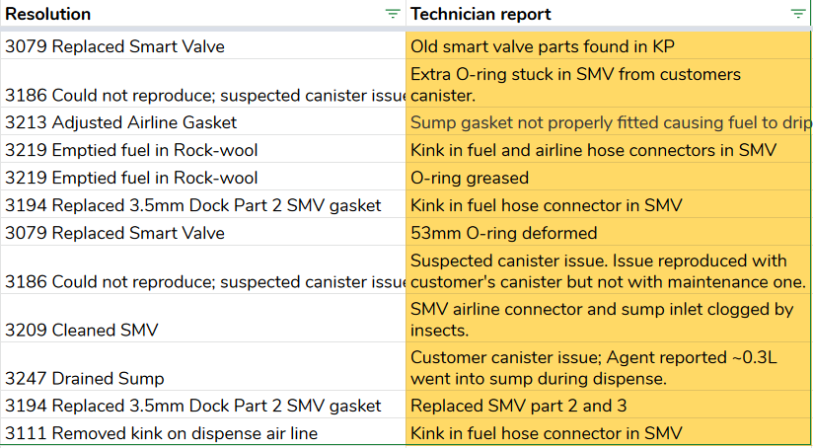
Analysis 2: Resolution vs Tech report
Some of the info was lost during translation of what was observed in the field and resolution applied.
This information is crucial in the root cause analysis therefore should be as accurate as can be (Feedback to NOC & Maintenance teams).

Slide 8
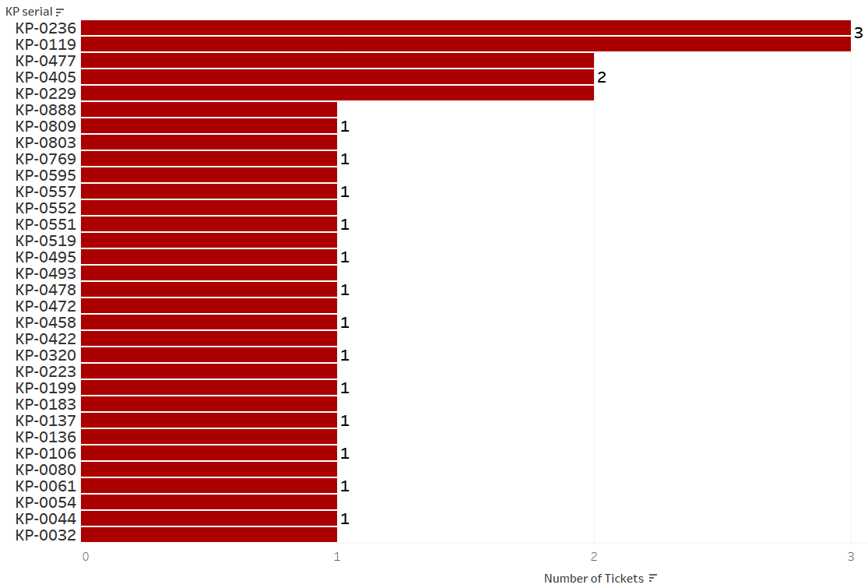
Analysis 3: Frequency by KP
Issue is spread across 32 KPs.
5 KPs have experienced more than 1 count of leakages.
Deep dive of the 5 KPs in next slide (plus KP-0557 added later on with a count of 2).

Slide 9
Analysis 3 Cont’d: Deep dive of 6 most frequent KPs.
KP Sr. | Freq. | Associated tickets | Summary
KP-0236 | 3 | 5th Sep - Old dock replaced with Final dock. 20th Sep - Dock replaced due to flooding. 7th Oct - Dock replaced due to flooding. 18th Dec - Customer under-dispense caused flooding. | 3 flooding SMV. 1 under-dispense causing flooding.
KP-0119 | 3 | 24th Feb - 53mm O-ring deformed. Smart valve replaced. 10th Mar - Customer under-dispense resulting to flooding. 23rd Mar - Smart valve replaced due to flooding. | 1 53mm O-ring deformed. 1 under-dispense causing flooding. 1 flooding SMV.
KP-0477 | 2 | 23rd Oct - SMV changed due to flooding. Ticketed twice. | 1 flooding SMV.
KP-0405 | 2 | 31st Jan - Customer under-dispense caused flooding. 3rd Feb - Issue could not be reproduced. 20th Feb - 53mm O-ring greased. 11th Feb, 12th, 20th, 23rd, 30th March - Under-dispenses. | 6 under-dispense cases.
KP-0229 | 2 | 15th Jan - Gasket btn dock and sump not well fitted. 5th Mar - Smart valve replaced due to flooding. 23rd Mar - Customer reported an under-dispense. | 1 leakage from dock area. 1 flooding SMV. 1 under-dispense case.
KP-0557 | 2 | 15th Dec, 14th Jan - Customers reported an under-dispense. 21st Feb - Kink in fuel hose inside the SMV. Ticketed twice. 9th Mar - Customer reported an under-dispense. | 1 kink in fuel hose. 2 under-dispense cases.

Slide 10
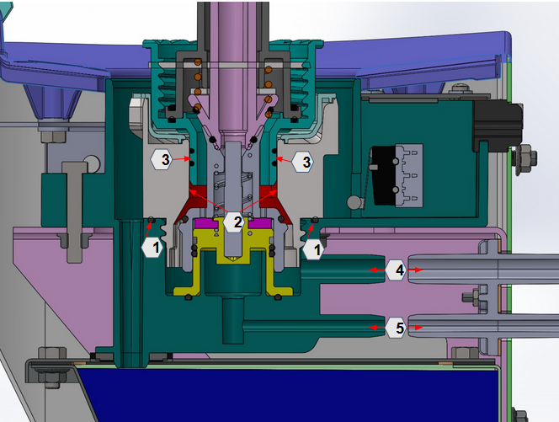
Analysis 4: SMV Flooding & Leaking root cause.
O-ring: Out of place, missing or damaged o-ring can cause slow leakage of fuel into the dock holder & down into the sump causing KP leakage when full.
Lack of proper compression of o-ring by part1 due to missing lock pin or loose screw mating of part1 into dock holder also causes flooding & leakage.
The lock pin not mating with its specific hole in part1 to avoid movement can also cause a loose screw mate and subsequent leakage.
Part 1 Bore: Part 1 inside being bigger than 29.2mm means a loose fit with canister hence leading to flooding as fuel can pass between canister and part 1. This can happen from fabrication or wearing out of the plastic with use.
Canister o-ring & plastic: Worn out canister o-ring and indicated part also leads to the same flooding indicated in No.2 above.
5cm Hose: Loosely fitted (hose clips) or damaged fuel hose can cause drips during dispenses that go into bucket directly & cause leakage when full.
*A kink/twist in this hose can also cause a strain on the pump & reduced flow rates due to the constriction
Flooded Air Line: Fuel past 14ml in the airline can flow back into the smart valve and flood the dock area. If damaged/loose, fuel in the air line can drip into the bucket area.
5b. A kink in the airline also leads to a pressurized canister, flooding then eventually error 092.

Slide 11
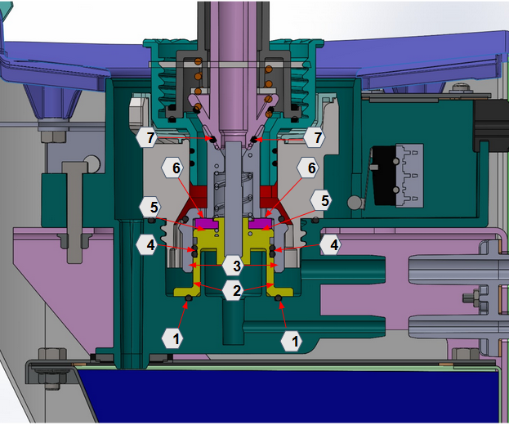
Analysis 4 Cont’d: SMV Fuel in the airline root cause
O-ring: Damaged, out of place & loosely compressed o-ring can create a way for fuel to seep into the return airline. This can also be caused by a part2 fitted wrongly into the dock holder.
Part2: Lack of circularity during injection molding & large tolerance deviation from the drawing dimensions causes a lot of space & play between dock holder-part 2 & part 2-part 3. Fuel seeps into the airline between the contact spaces of these parts.
Part3: Lack of circularity during injection molding & large tolerance deviation from the drawing dimensions causes a lot of space & play between part3-part2 during actuation. This can cause a slight tilt in part2 which doesn’t completely sit on the gasket thus allowing fuel into the airline.
O-ring:Wearing out of the o-rings & formation of grooves in part 2 due to friction during actuation causes space between the parts for fuel to go through into the airline.
Part 2: Deformation of gasket seat on part 2 during fabrication can cause the gasket to become slightly concave hence not closing off the holes on part 2 when actuated. Fuel can pass through these holes and gap into the airline during canister refill.
Gasket: Lack of uniformity and smooth gasket top surface can cause partial opening of some of the through holes on part 3 during actuation. Fuel can seep through these holes during a canister refill.
O-ring: Wearing out of the o-rings & formation of grooves in part 2 slanting faces causes a gap for fuel to seep into the airline during a canister refill.

Slide 12
Deductions from SMV root cause analysis
The current design of the SMV makes it prone to the following issues as outlined in the last 2 slides:
Flooding of the dock.
Leaking from dock area.
Fuel going back into the airline.
Therefore troubleshooting and QC can be done focusing on the potential areas shown in the slides.
Also this will be used as design feedback for the next set of smart valves to be produced.

Slide 13
Analysis 5: Data from reworked SMVs
Analysis done based on the data logged in during rework of faulty SMVs from the field.
Gaps identified:
Most of the information on the specific issue discovered in the field is not available to the person carrying out the rework investigation.
Missing data on what got done and why a particular part was replaced during rework.
Lack of a structured rework troubleshooting process.

Slide 14
Recommendations based on analysis:
Specificity in ticket description: KP leakage is too general, instead have sth like SMV flooded or Canister dock area leakage or a separate code for them.
Eliminate having different names for similar resolutions.
Avoid loss of info and crucial details when translating between what was done in the field and the resolution applied.
Improve on visibility of observations identified in the field to the person carrying out the rework process.
Develop a standard SMV troubleshooting/rework procedure and accurate way of logging in data that will be useful for analysis.
General cross-departmental training on the internal working of the SMV is required for the Maintenance, Sub-assembly, QC & Calibration teams.
Continuous rework process to have spares available beforehand.

Slide 15
Outcomes of recommendations
Development of a standard SMV repair manual that aids in troubleshooting of the issues.
More detailed and improved data logging of the findings from the rework process in the Rework Report.
Development of a SMV plastic parts QC procedure since the plastic parts are suspected to be the biggest contributor of the leakage issues.
Feedback given to Maintenance team to be as accurate as possible when logging in their field findings.
Feedback provided to the Design team on areas to focus on during fabrication and quality check of the next SMV design. A request for involvement of the Production Engineering team during the process has been submitted - On going
Development of simulations of the internal working of the SMV and different failure modes to give a clearer understanding of the SMV functionality - On going
Development of a KP canister dock training guide that will be used to improve on the team’s knowledge on the SMV for better troubleshooting - On going

Slide 16
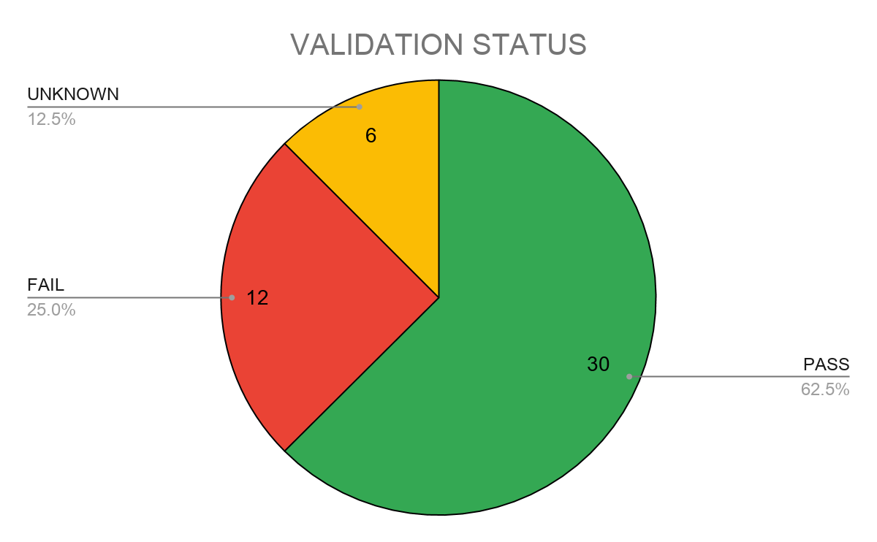
Other: Effects of dock replacement on dispense accuracy
30 out of 48 KPs passed verification after their docks had been swapped.

